Slide 1
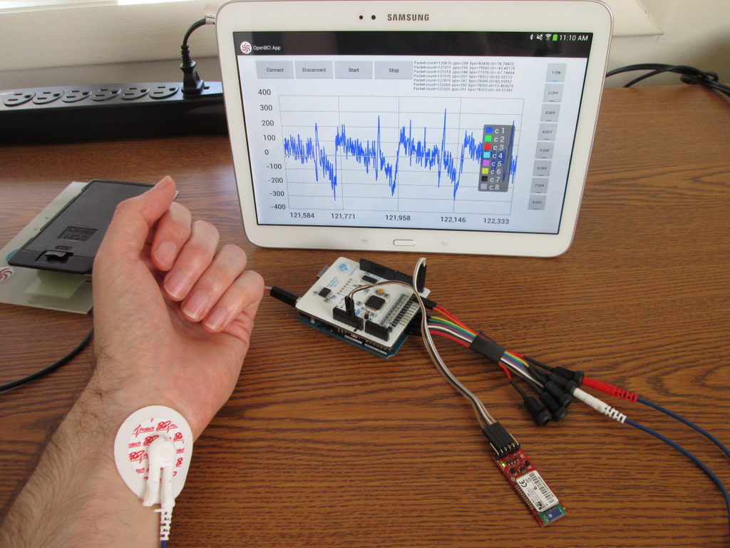
Android
Tablet
OpenBCI
App
ECG
Electrode
OpenBCI
w/Arduino
Bluetooth
Module

Slide 2
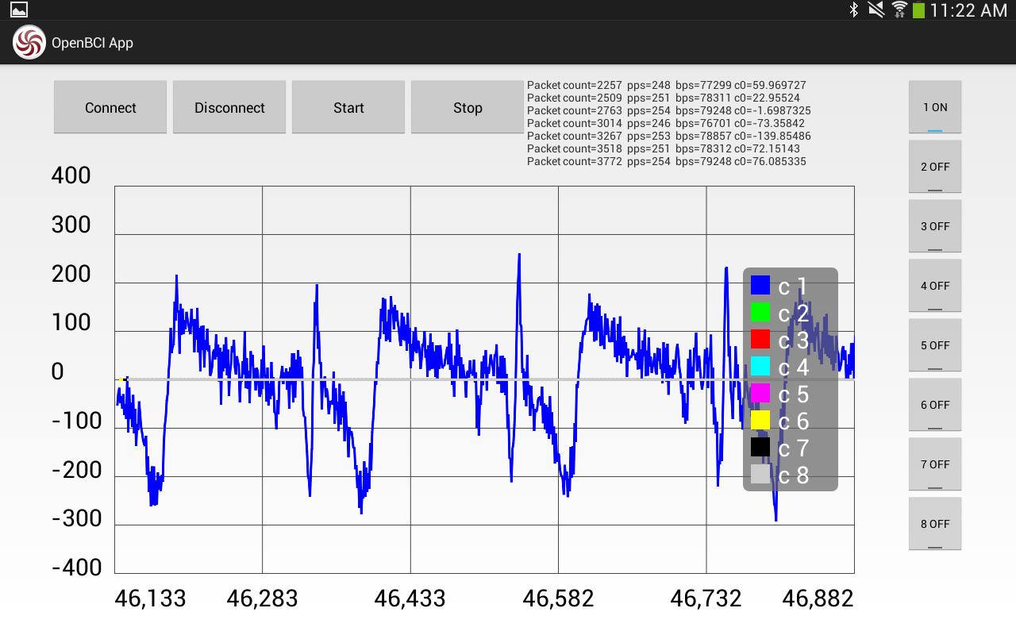
Bluetooth
Control
OpenBCI
Start/Stop
Raw Data
Monitoring
EEG
Channels
Real-Time
Plotting
All Data is
Logged To Disk

Slide 3
Bluetooth
Control
OpenBCI
Start/Stop
Raw Data
Monitoring
EEG
Channels
Real-Time
Plotting
All Data is
Logged To Disk

